Slide 1



Nick’s easy CTF
(Steganography)

Slide 2
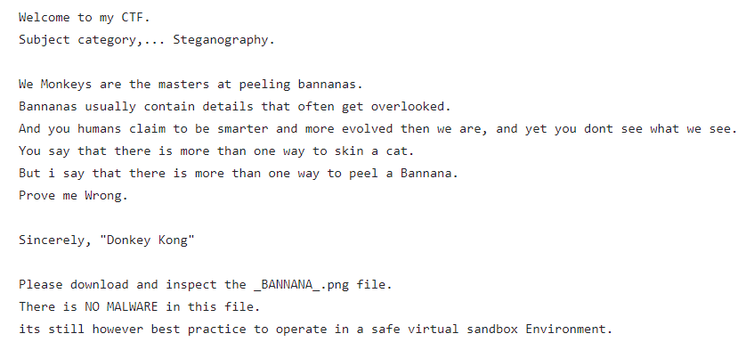
- Read the introduction to the CTF - Download the .wav file

Slide 3
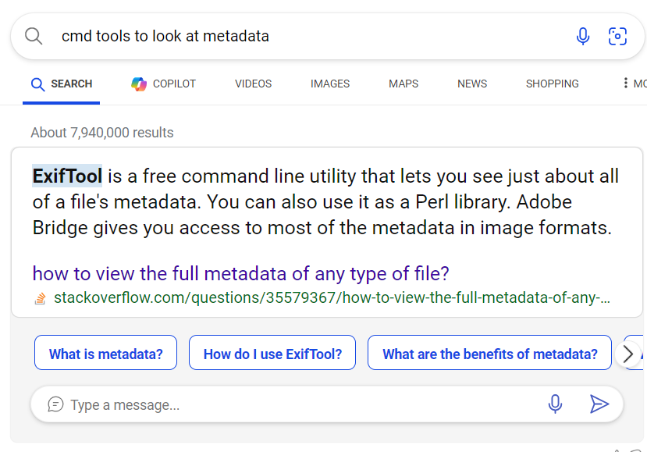
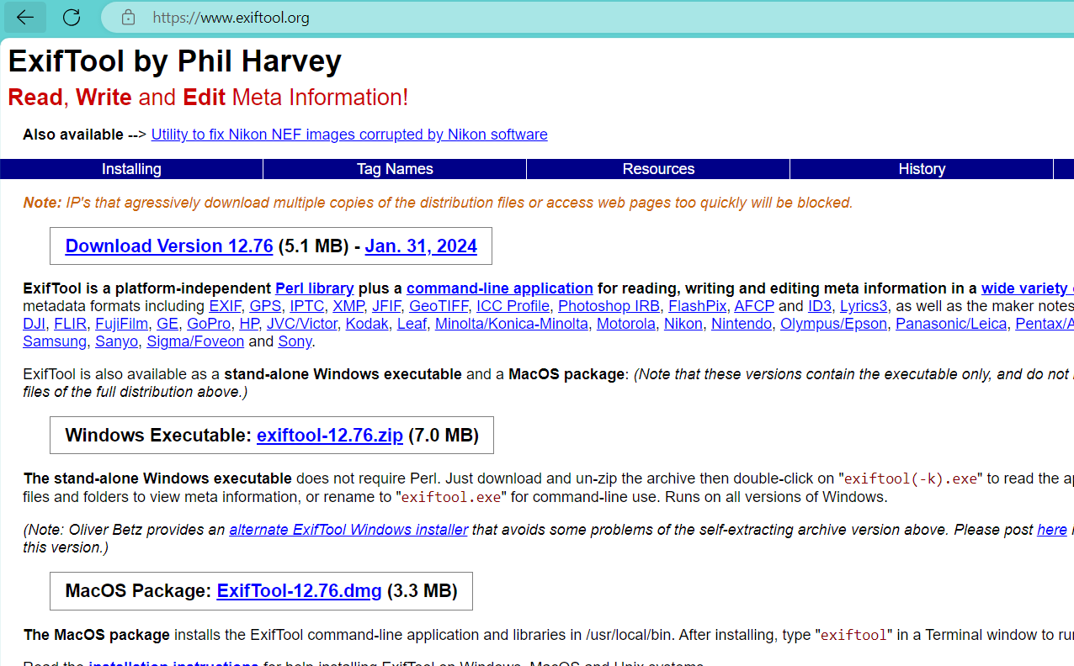
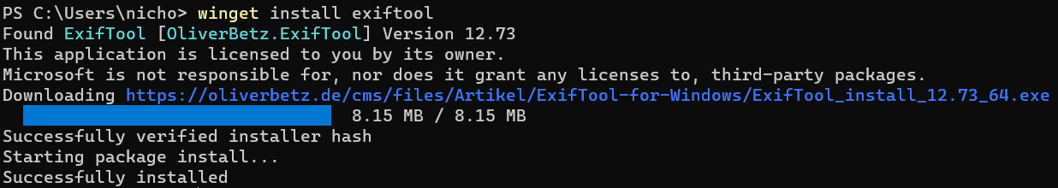
- Do research to discover “exiftool” to look at metadata. - Use packet manger to install exiftool.

Slide 4
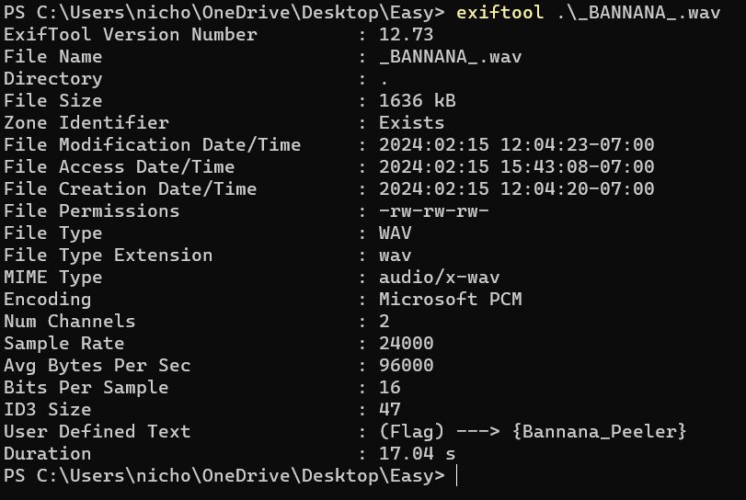
- Run the tool against the .wav file to discover the flag.

